Slide 1
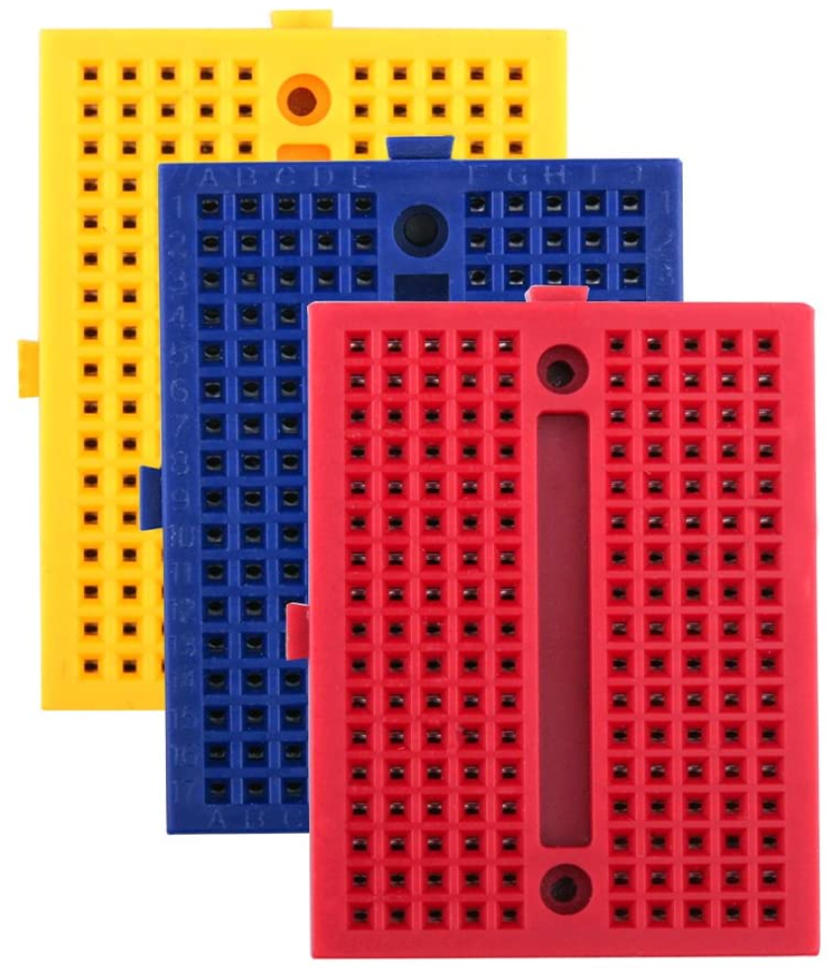

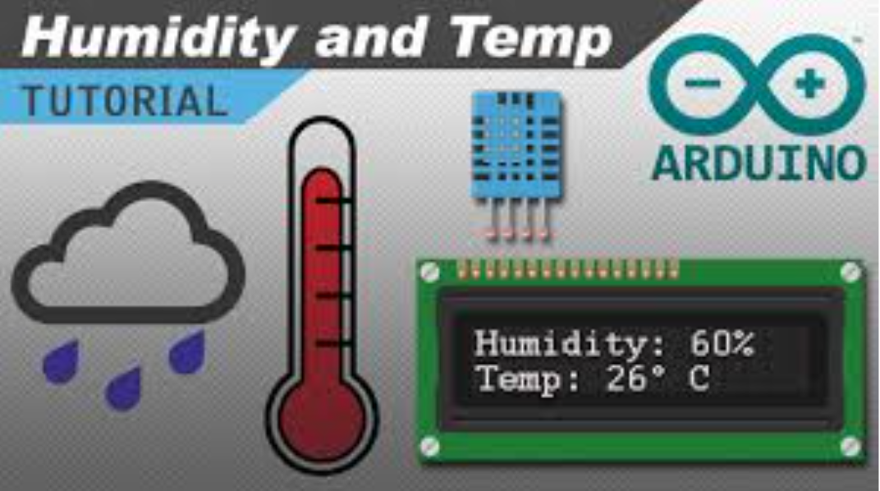
Getting Started with ESP32 & DHT11
IoT with ESP32
Module 2a
safyzan salim
019 622 0575
| IoT with ESP32 | Rev01-JAN2021 |

Slide 2
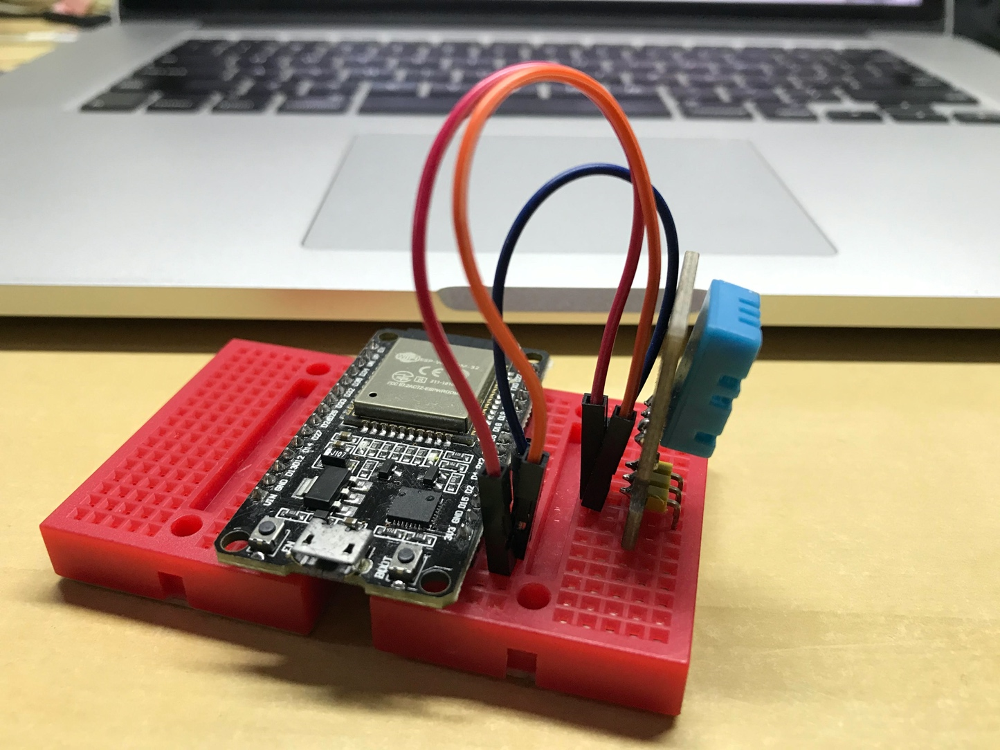
2a. Getting Started with ESP32 & DHT11
Project Overview
This is a tutorial on connecting temperature & humidity sensor, DHT11 to ESP32. This activity is to show that ESP32 able to work as Arduino Uno, Mega, Nano, etc. (in case that you do not have Uno or Mega around). At the end of the class, you will be able to:
→ Install additional library.
→ Connection between ESP32 & DHT11.
→ Capture temperature & humidity value and display at Serial Monitor.
Rev01 JAN2021

Slide 3
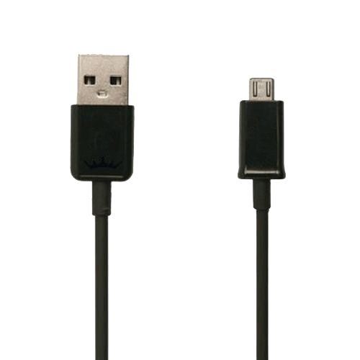
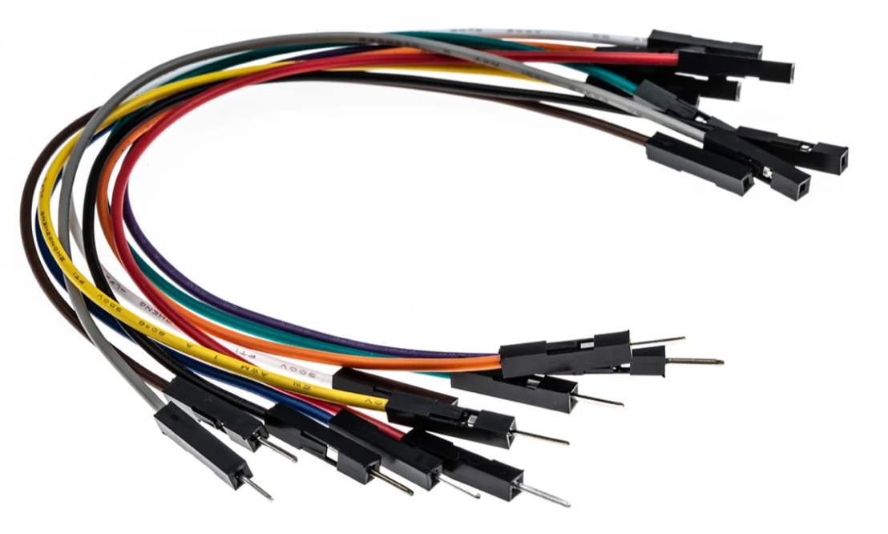
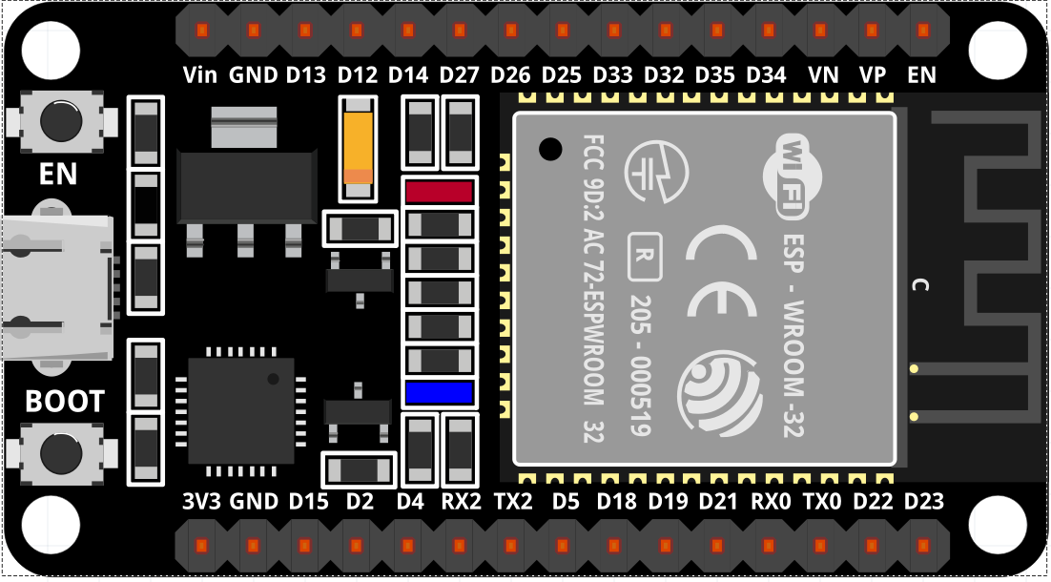
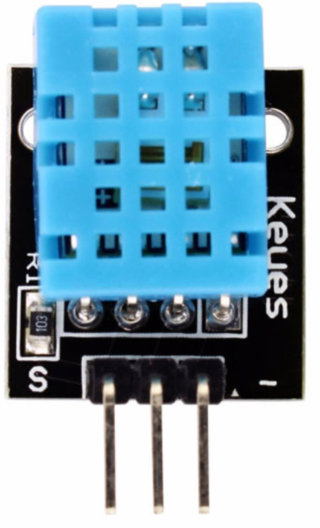
2a. Getting Started with ESP32 & DHT11
Components
→ 1 x ESP-32 Wifi+Bluetooth 2-In-1 Development Board for Arduino (30 pin) + Cable.
→ 1 x Temperature & Humidity Sensor, DHT11.
→ Jumpers (male to female).
→ 2 x Mini Breadboard.
Rev01 JAN2021

Slide 4
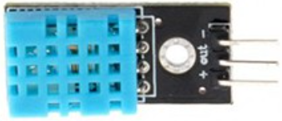
2a. Getting Started with ESP32 & DHT11
DHT11 Specsifications
→ Operating Voltage 3.3V to 5.5V.
→ Humidity measurement range 20% to 90% RH.
→ Humidity measurement accuracy ±5% RH.
→ Humidity measurement resolution 1% RH.
→ Temperature measurement range 0ºC to 50ºC [32ºF to 122ºF].
→ Temperature measurement accuracy ±2ºC.
→ Temperature measurement resolution 1ºC.
→ Signal transmission range 20m.
→ Weight is about 8g PCB Size: 3.2cm*1.4cm.
**RH = Relative Humidity
Rev01 JAN2021

Slide 5
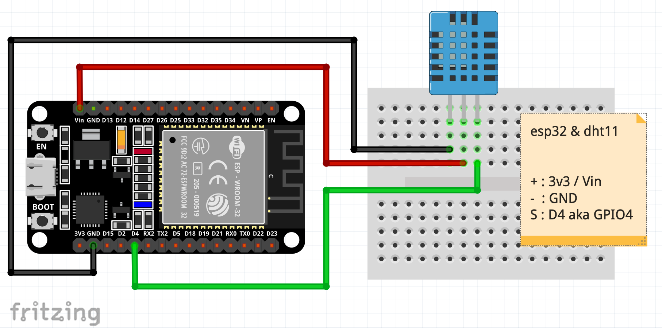
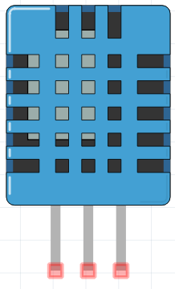
2a. Getting Started with ESP32 & DHT11
Schematic Diagram
→ Check a few time the connections that have been made before plugging ESP32 to USB port. This might prevent short circuit to DHT11. Watch out on sensors’ pin. Same type, doesn’t mean same pin configurations.
GND
Vin
Signal
Rev01 JAN2021

Slide 6


2a. Getting Started with ESP32 & DHT11
Working File
Installation of DHT11 library
→ Install the DHT11 library by download it from https://bit.ly/34FQdHr
→ Do not UNZIP the “dht11-main.zip”.
→ Launch the Arduino IDE.
→ Click Sketch > Include Library > Add .zip library … browse for “dht11-main.zip” & click to upload the zipped library.
→ Click File > Examples > Examples from Custom Libraries > dht11-main > dht_test.
→ Click upload button to upload the sketch to ESP32 board. Ensure that you have selected the right board and set the current port. Don’t forget to press BOOT button. Refer to Troubleshoot section if you have problem.
Rev01 JAN2021

Slide 7

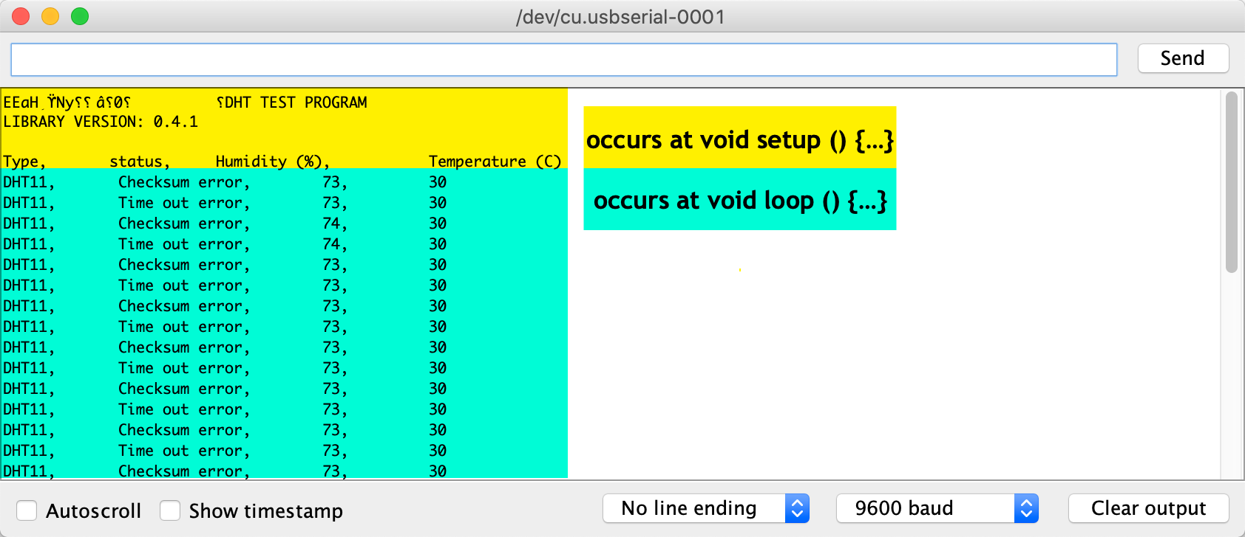
2a. Getting Started with ESP32 & DHT11
The Output
→ Click to open a window and view the output.
→ Both values will be update every 1 second.
→ There are several versions of DHT11 libraries which may lead to Checksum error and Time out error, nevertheless, the reading for both humid and temp is correct.
→ Display the serial data receive & transmit by ESP32.
Set baud rate to 9600
Rev01 JAN2021

Slide 8
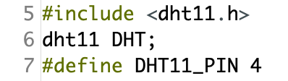
2a. Getting Started with ESP32 & DHT11
Code Explanation
→ Filename: dht11_test.ino .
→ This sketch consists of 2 functions:
void setup( ), void loop( )
→ The sketch starts with:
dht11.h : an Arduino low cost library for temperature & humidity sensor.
dht11 DHT : create DHT object to access the functions within the library.
#define DHT11_PIN 4 : set pin D4 as input signal from DHT11.
Rev01 JAN2021

Slide 9
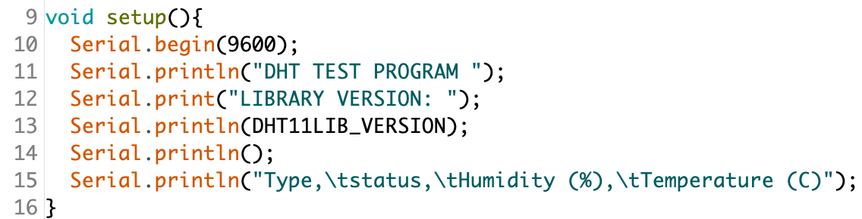
2a. Getting Started with ESP32 & DHT11
Code Explanation
Line #9 - #16 took place in void setup( ) function
→ The void setup( ) {…} function is the first function to run. Lines written in here run once at the very beginning. Every power up, reset or upload new sketch, ESP32 will invoke setup( ) function. Initialization of pin modes and variables also will be done here.
→ Serial communication at respective port will start with data rate of 9600. This will allow us to see information/values/data/send & receive/input & output activities in ESP32 on your computer/laptop thru Serial Monitor by using Serial.print( ) command.
Rev01 JAN2021

Slide 10
2a. Getting Started with ESP32 & DHT11
Code Explanation
Line #18 - #42 are in void loop( ) function
→ The loop( ) {…} function will keep looping infinitely. The sketch written in side this function will run over & over as long the board is still turned on.
→ Input such as sensors and output such as servos, motors & LEDs are written here. Calculation or formula can be written within this function. Not to forget, conditions & rules too.
→ DHT11 will feed the reading to ESP32 via D4. At least 3 important information are fed into ESP32 via DHT11; DHTLIB status (0,1 or 2), humidity value & temperature reading.
→ Serial.print(val, format) - val is data captured at D4; format can be decimal (0), binary (2), octal (3), etc. & determine number of floating point.
→ Remember that writing a program is like baking a cake. You cannot simply skip the recipe order list otherwise the food become different.
Rev01 JAN2021

Slide 11
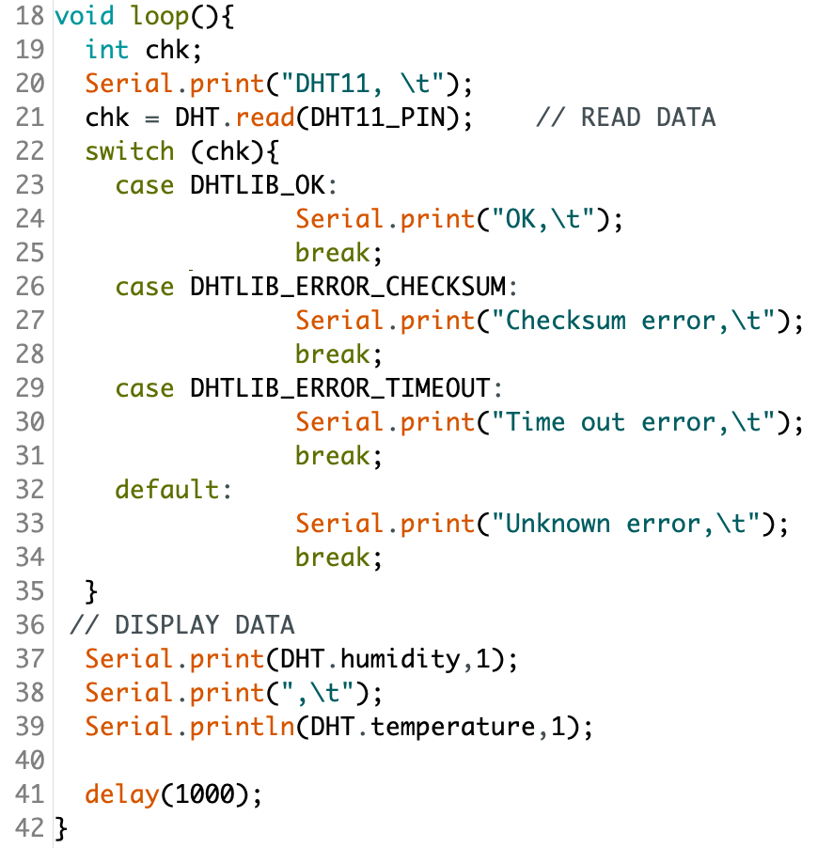
2a. Getting Started with ESP32 & DHT11
Code Explanation
Start of switch.. case statement
End of switch.. case statement
Rev01 JAN2021

Slide 12
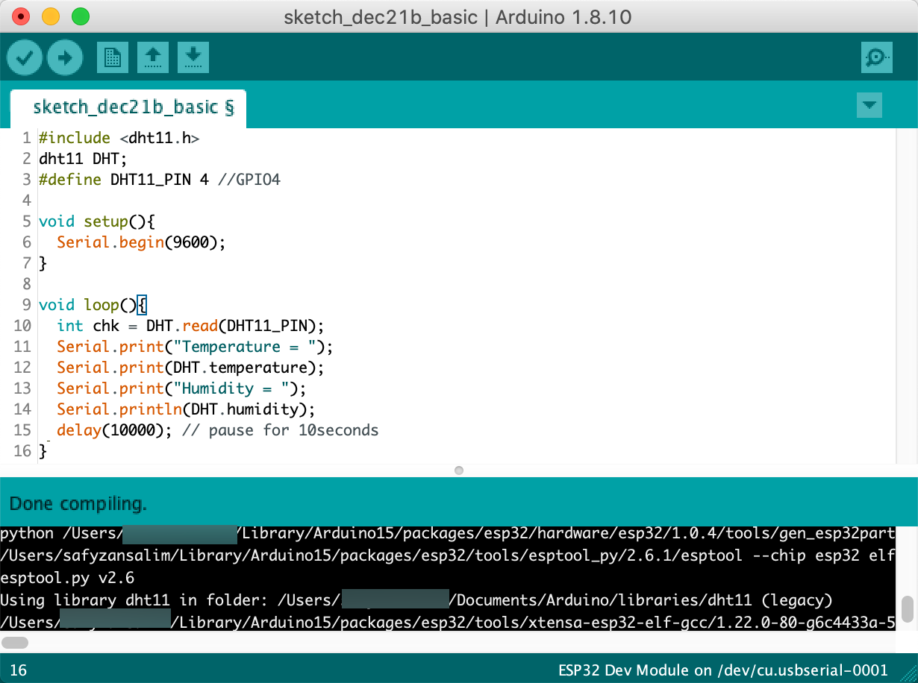
2a. Getting Started with ESP32 & DHT11
Simpler Sketch
Rev01 JAN2021

Slide 13
2a. Getting Started with ESP32 & DHT11
QUESTIONS?
Questions?
Rev01 JAN2021

Slide 14
2a. Getting Started with ESP32 & DHT11
EXERCISE
Change to other GPIO, upload new sketch and observe the output.
[10 minutes activity]
Rev01 JAN2021

Slide 15
2a. Getting Started with ESP32 & DHT11
TROUBLESHOOT GUIDE
Failed to upload the sketch to ESP32? Follow these steps:
→ Press REBOOT button until the IDE approaches Connecting… segment;
→ OR, check whether you have chosen the correct Board and set the correct PORT;
* Choose the right board by going to Tools > Boards > ESP32 Dev Module
* Select the correct port at Tools > Port > choose the appropriate serial port
→ OR, unplugging the board from USB and plugging back;
→ OR, Verify to confirm that your sketch is error free;
→ OR, Swap to other PC / Laptops;
→ OR, Use different board;
→ You are using micro-USB power cable instead of power & data cable.
Rev01 JAN2021

